Slide 1
Serial Communication Interfaces
Lecture 12, 13

Slide 2
Serial Communication Interfaces

Slide 3
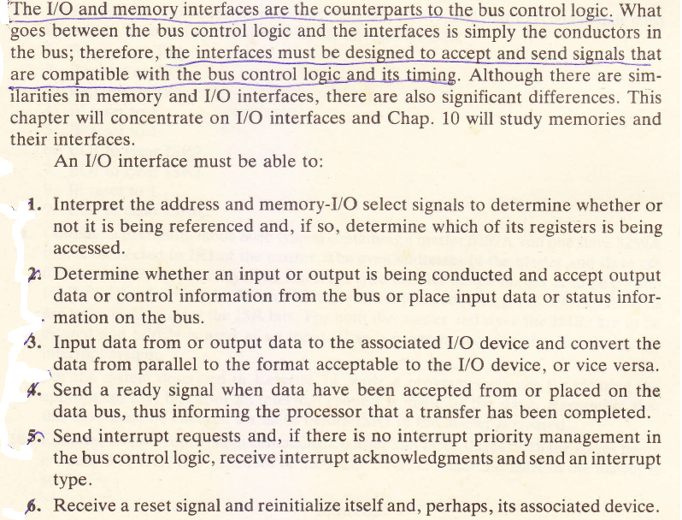


Slide 4
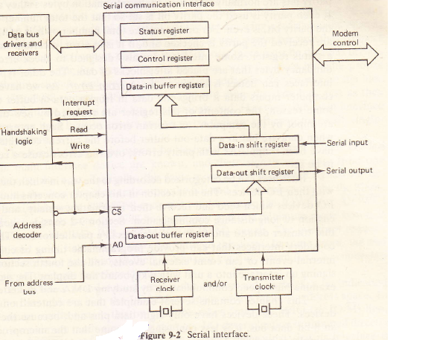
SERIAL COMMUNICATION INTERFACES
Many I/O devices transfer information to or from a computer serially, i.e., one bit at a time over a single conductor pair or communication channel, with each bit occupying an interval of time having a specified length.
There are several serial interface devices and typically they are constructed as shown in Fig. 9-2.
The status register would contain error and other information concerning the state of the current transmission
The control register is for holding the information that determines the operating mode of the interface.

Slide 6
The data-in buffer is paired with a serial input/parallel output shift register. During an input operation, the bits are brought into the shift register one at a time and, after a character has been received, the information is transferred to the data-in buffer register, where it waits to be taken by the CPU. (Although a single datum is not necessarily an alphanumerically coded character, it normally is and, therefore, it will be referred to as a character.)
Similarly, the data-out buffer is associated with a parallel input/serial output shift register.
An output is performed by sending data to the data-out buffer, transferring it to the shift register, and then shifting it onto the serial output line.
Although there are several ways in which the four port registers could be addressed, it has been assumed that the status register can only be read from and the control register can only be written into.
Therefore, an active signal on the read line would indicate either the status or data-in buffer register and A0 could be used to distinguish between these two possibilities. Likewise, the write and A0 signals can be used to designate one of the other two registers.

Slide 7
The interface shown in Fig. 9-2 has separate lines for sending and receiving information.
When different lines are used for the two signal directions the communication system is said to be full duplex .
Such a system can transmit and receive at the same time.
Terminals and other serial devices that are connected to a computer through a full duplex system normally send each character to the computer without displaying it.
The computer immediately sends the character back, or echos the character, and the terminal then displays it.
There is no loss of time because the echoed characters can be sent back at the same time new characters are being input by the computer.
The advantage of this scheme is that the user gets visual verification not only that he has struck the correct key, but also that the correct character was received by the computer.

Slide 8
The alternative, called half duplex, is to use the same line for both inputting and outputting.
In this case a character typed into a terminal is displayed at the same time it is sent to the computer, and echoing is not used. If the computer has been receiving characters
And then wishes to send characters, or vice versa, the communication link must be turned around, a process that requires time. Although full duplex avoids turn-arounds and provides echoing, it does require an extra line.

Slide 9
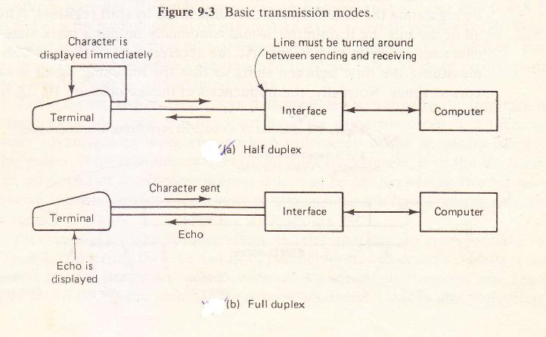

Slide 10
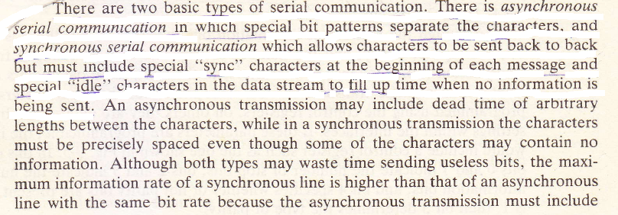


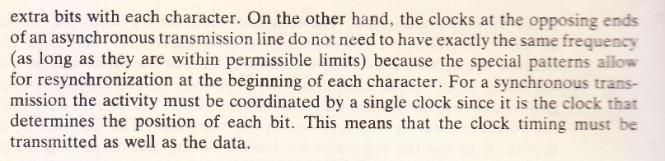

Slide 11
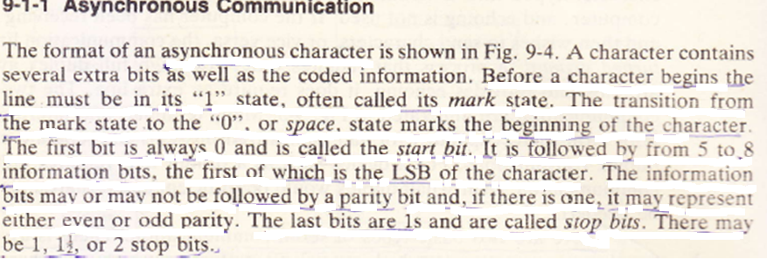

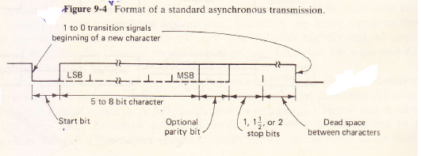

Slide 12
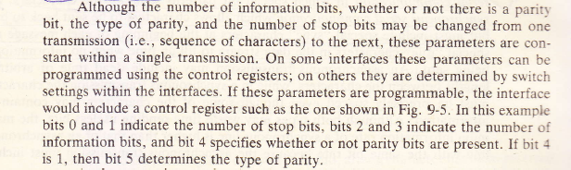
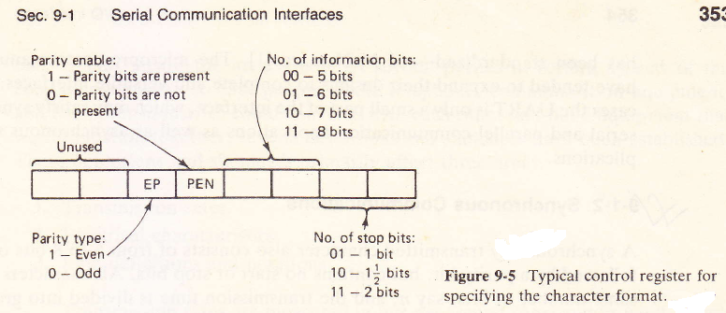

Slide 13
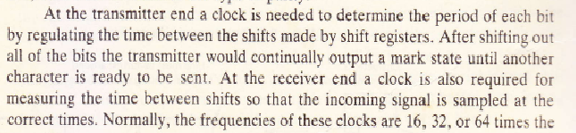
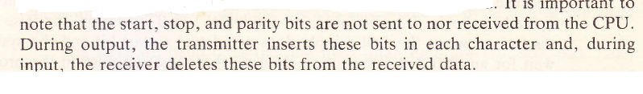

Slide 14
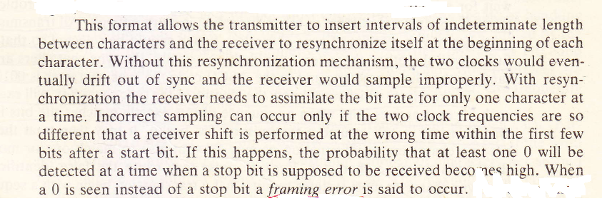


Slide 15
Synchronous communications
A synchronously transmitted character also consists of from 5 to 8 bits optionally
followed by a parity bit, but contains no start or stop bits.
All characters have the same number of bits, say n, and the transmission time is divided into groups of n bits each.
The same clock controls the sampling by the receiver as is used to generate
the bits, thus guaranteeing the synchronization of the two processes.
The transmitter must transmit a character during each n-bit interval. If a character is not available at the beginning of an interval, an underrun is said to occur and the transmitter will insert an idle character.
Depending on the system, idle characters may be interpreted as errors, called underrun errors, by the receiver.

Slide 16
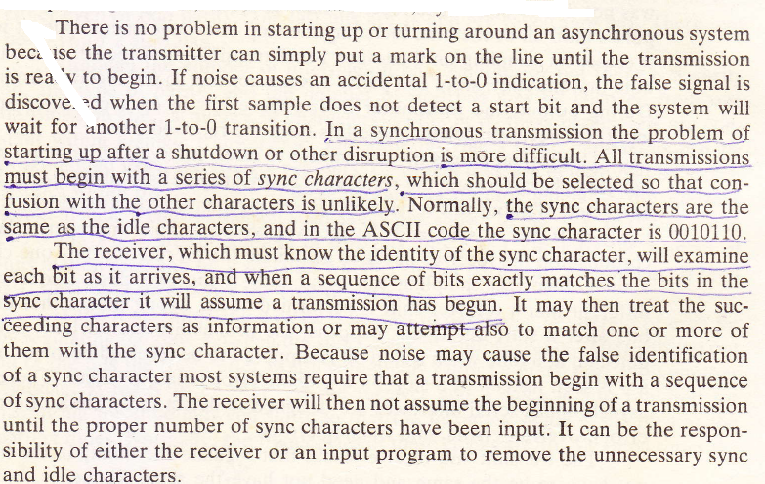

Slide 17

8251A Programmable Communication Interface
As an example of a serial interface device let us consider Intel’s 8251A programmable communication interface.
It is capable of being programmed for asynchronous or synchronous communication. The data in buffer and data out buffer registers share the same port address.
For input, the serial bit stream arriving on the R×D pin is shifted into the receiver shift register and then the data bits are transferred to the data-in buffer register, where they can be input by the CPU.
Conversely, on output the data bits put in the data-out buffer register by the CPU are transferred to the transmitter shift register and, along with the necessary synchronization bits, are shifted out through the TxD pin.
Among other things the contents of the mode register, which are initialized by the executing program, determine whether the 8251A is in asynchronous mode and the format of the characters being received and transmitted.

Slide 18
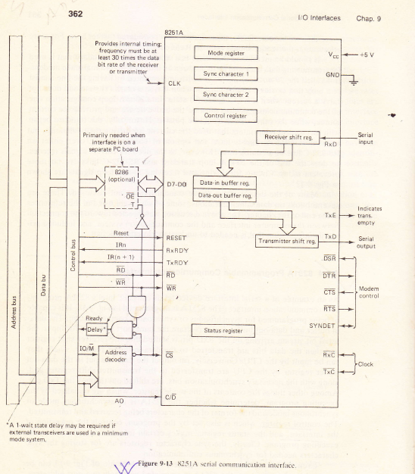

Slide 19
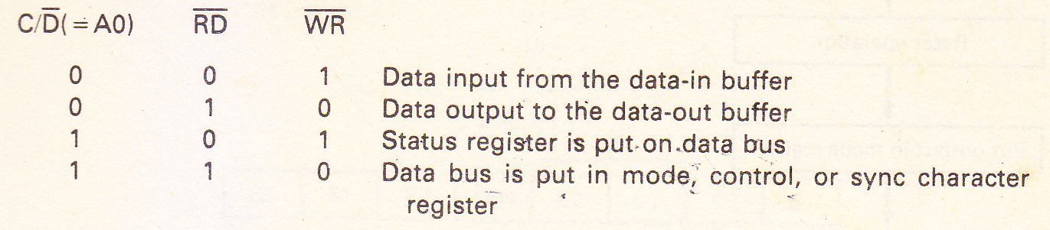
The control register, which is also set by the program, controls the operation of the interface, and the status register makes certain information available to the executing program.
Clearly, the sync character registers are for storing the sync characters needed for synchronous communication.
Even though all seven, of the registers on the left side of Fig. 9-13 can be accessed by the processor, the 8251A is associated with only two port addresses.
The C/D pin is connected to the address line A0 and A0 differentiates the two port addresses.
The 8251A internally interprets the C/D, RD, and WR signals as follows:

Slide 20
where 1 means that the pin is high and 0 means that it is low. All other combinations cause the three-state D7-D0 pins to go into their high-impedance state.
Whether the mode, control, or sync character register is selected depends on the accessing sequence.
A flowchart of the sequencing is given in Fig. 9-14. After a hardware reset or a command is given with its reset bit set to 1, the next output with A0=1 (i.e., with C/D=1, RD=1, and WR=0) is directed to the mode register.

Slide 21
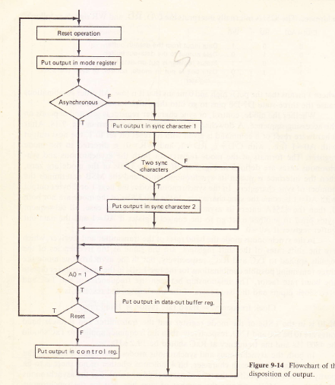

Slide 22
The formats of the mode register for both the asynchronous and synchronous cases are defined in Fig. 9-15.
If the two LSBs of the mode are zero, then the interface is put in its synchronous mode and the MSB determines the number of sync characters. In the synchronous mode, the next 1 or 2 bytes output with A0= 1 become the sync characters.
If the two LSBs of the mode are not both 0, then the 8251A enters its asynchronous mode. In either case, all subsequent bytes prior to another reset go to the control register if A0 = 1 and the data-out buffer register if A0=0.
In the synchronous mode the baud rates of the transmitter and receiver, which
are the shift rates of the shift registers, are the same as the frequencies of the
signals applied to TxC and RxC, respectively, but in the asynchronous mode the
three remaining possible combinations for the two LSBs in the mode register dictate the baud rate factor.
The relationship between the frequencies of the TxC and RxC clock inputs and the baud rates of the transmitter and receiver is:
Clock frequency = Baud rate factor x Baud rate

Slide 23
If 10 is in the LSBs of the mode register and the transmitter and receiver baud
rates are to be 300 and 1200, respectively, then the frequency applied to TxC- should be 4800 Hz and the frequency at RxC should be 19.2kH2.
In both the asynchronous and synchronous modes, bits 2 and 3 indicate the
number of data bits in each character, bit 4 indicates whether or not there is to be
parity bit, and bit 5 specifies the type of parity (odd or even).
For the asynchronous mode the two MSBs indicate the number of stop bits, but for the synchronous mode bit 6 determines whether the SYNDET pin is to be used as an input or as an output and, as mentioned above, bit 7 indicates the number of sync characters.
If the SYNDET pin is used as an output it becomes active when a bit-for-bit match has been found between the incoming bit stream and the sync character(s).
If the search for sync characters is conducted by an external device, then SYNDET
can be used to input a signal, indicating that a match has been found by the external
device.
The pin also has a meaning during asynchronous operation, but in this case it can only be an output. This output is called the break detect signal and goes high whenever a character consisting of all 0s is received.

Slide 24
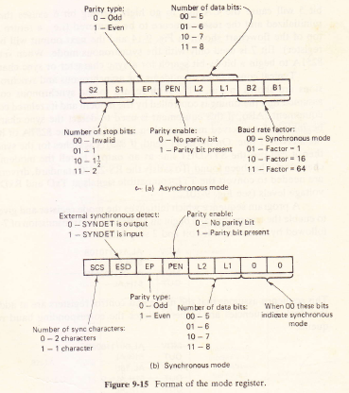

Slide 25

PARALLEL COMMUNICATION
Parallel communication is accomplished by simultaneously transferring bits over
separate lines.
Its advantage over serial communication is that for lines with a given maximum bit rate, higher information rates can be attained due to the use of several lines.
The disadvantage is, of course, the cost of the extra lines and, because these costs increase with distance, parallel communication is used over long distances only if high data rates are required.
Unlike serial communication, parallel communication has not been well stand- ardized.
Parallel transfers may be performed by simply putting data in the interface's data-in buffer register or taking data out of the interface's data-out buffer register, or they may be conducted under the control of handshaking and/or timing signals.
Normally, one character (or other piece of information) is transferred at a time
and there is no problem in determining the end of a character or in finding the
beginning of a transmission.

Slide 26
There is no well-defined format for synchronous or asynchronous transmissions, but if a timing signal is to coordinate the activity between the device and the interface, the transmission would be considered synchronous.
If only handshaking signals are employed, the transmissions would be asynchronous.
An interface may be designed for only outputting, only inputting, inputting and outputting over separate sets of lines, or performing I/O over a single set of bidirectional lines.
If an interface is connected to a line printer, it would only output data, and if it services a card reader, it would only input data.
An interface that services both a paper tape reader and a paper tape punch would require one set of input lines and one set of output lines, but an interface for a device that does not input and output data simultaneously could use only one set of bidirectional lines.

Slide 27
A typical parallel output interface which uses no control lines is given in Fig. 9-20(a).
In this case the contents of the data buffer register would continually be maintained on the data lines connecting the interface and the output device.
If the output device consisted of a latch and a set of relays that are controlled by the bit settings in the latch, then the computer could control the relays by simply outputting data to the data buffer register.
Figure 9-20(b) shows a representative parallel interface with handshaking
control lines and separate input and output connections to an I/O device.
In this case, an input would be carried out by first putting the data on the data bus and a 1 on the data-in ready line.
The interface would respond by latching the data into the data-in buffer and putting a 1 on the data-in acknowledge line.
Upon receiving the acknowledgment the device would drop the data and ready signals.

Slide 28
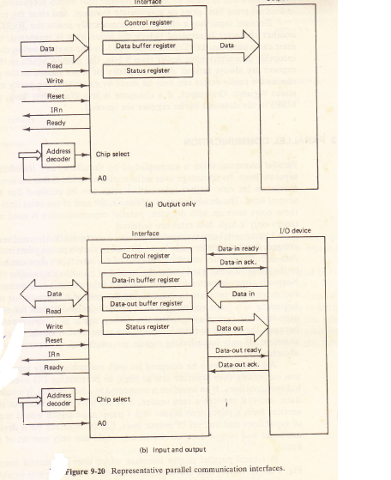

Slide 29

When the data are received by the interface, it would set a "ready" status bit and
perhaps send out an interrupt request.
After the CPU takes the data the interface would clear the "ready" status bit and put the data lines in their high-impedance state. If an interrupt request were made, it would be handled in the usual manner.
For an output, the interface would set a "ready" status bit and, perhaps, make an interrupt request when the data-out buffer is available.
After the CPU outputs the data, the interface would clear the output "ready" status bit, put the data on the data-out bus, and signal the I/O device over the data-out ready line.
When the device is ready to accept the data, it would latch the data and then return an acknowledgment.
The interface would then drop its data-out ready signal and once again set the output "ready" status bit.

